Slide 1

Presented by:
22D41A3310(B.VENU)
22D41A3311(B.RAJESH)
22D41A3312(B.VARUN REDDY)
TOPIC:
Customer Billing SYSTEM USING DATA STRUCTURES

Slide 2
Customer Billing SYSTEM USING DATA STRUCTURES
SlideMake.com

Slide 3

Introduction to Customer Billing System Using Data Structures
A customer billing system is a software solution that automates the process of generating and managing invoices for customers.
Data structures play a crucial role in organizing and manipulating the customer data required for billing purposes.
This presentation will explore the different data structures used in customer billing systems and their benefits.
Notes:
Image source: https://www.studytonight.com/c-projects/customer-billing-system-project-using-c-language

Slide 4
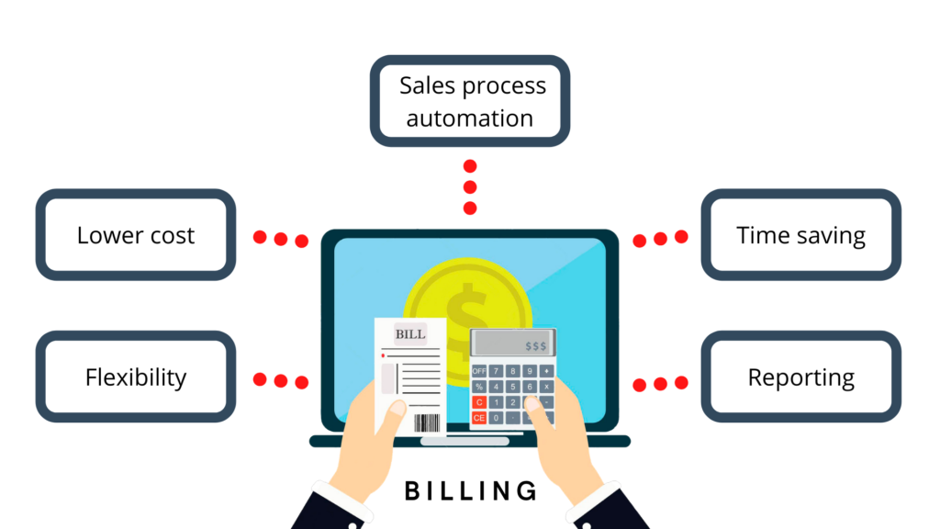
Advantages of Using Data Structures in Billing Systems
Data structures provide efficient storage and retrieval mechanisms for customer data, ensuring quick access to information when generating invoices.
By using appropriate data structures, the system can handle large amounts of customer data without compromising performance.
Data structures enable the implementation of complex billing calculations, such as discounts, taxes, and recurring charges, ensuring accurate invoicing.
Notes:
Image source: https://aionys.com/how-to-choose-the-right-billing-system-for-your-saas-business/

Slide 5
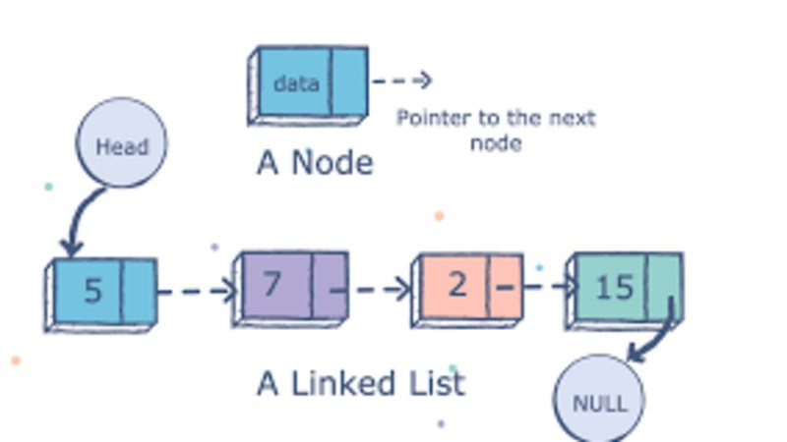
Linked Lists for Customer Data Management
Linked lists are a dynamic data structure commonly used for managing customer data in billing systems.
Each node in the linked list represents a customer and contains relevant information such as name, address, and billing details.
Linked lists allow for easy insertion, deletion, and traversal of customer records, facilitating efficient billing operations.
Notes:
Image source: https://studiousguy.com/singly-linked-list-in-data-structure/

Slide 6
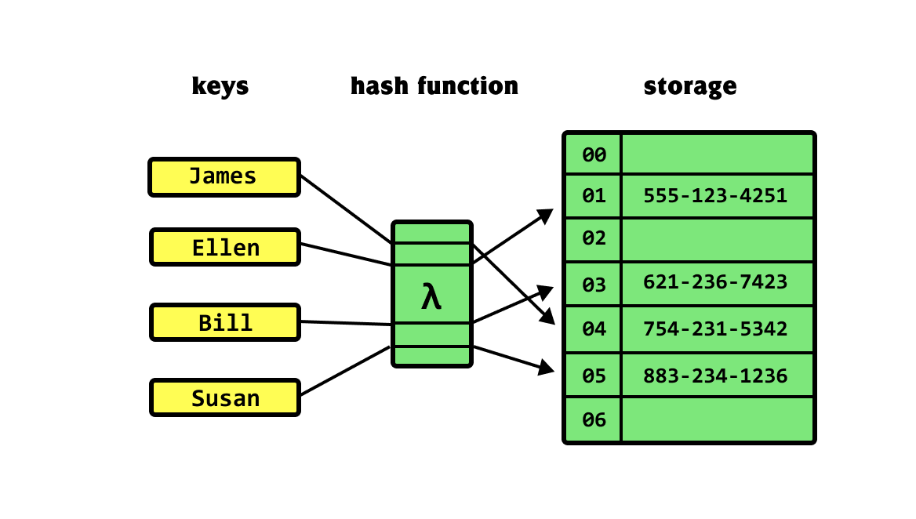
Hash Tables for Fast Customer Lookup
Hash tables provide a fast lookup mechanism for retrieving customer information based on unique identifiers such as account numbers.
Customer data is stored in key-value pairs, where the key is the unique identifier and the value is the customer record.
Hash tables ensure constant-time access to customer information, making them ideal for real-time billing systems.
Notes:
Image source: https://khalilstemmler.com/blogs/data-structures-algorithms/hash-tables/

Slide 7
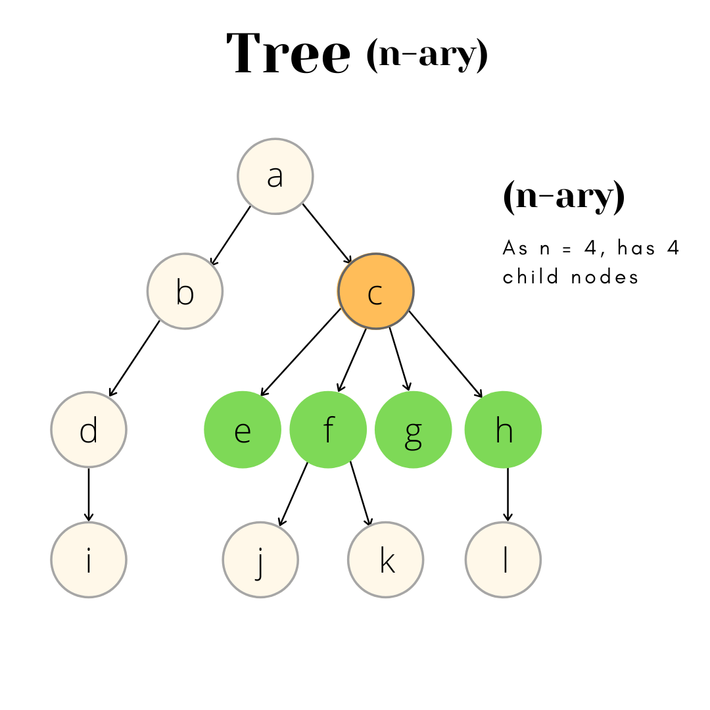
Trees for Hierarchical Customer Organization
Trees are hierarchical data structures that can be used to represent customer organizations, such as parent-child relationships.
Each node in the tree represents a customer, and the links between nodes depict the hierarchical structure.
Trees enable efficient organization and retrieval of customer data, making them suitable for billing systems with complex customer hierarchies.
Notes:
Image source: https://prepinsta.com/data-structures/types-of-trees/

Slide 8
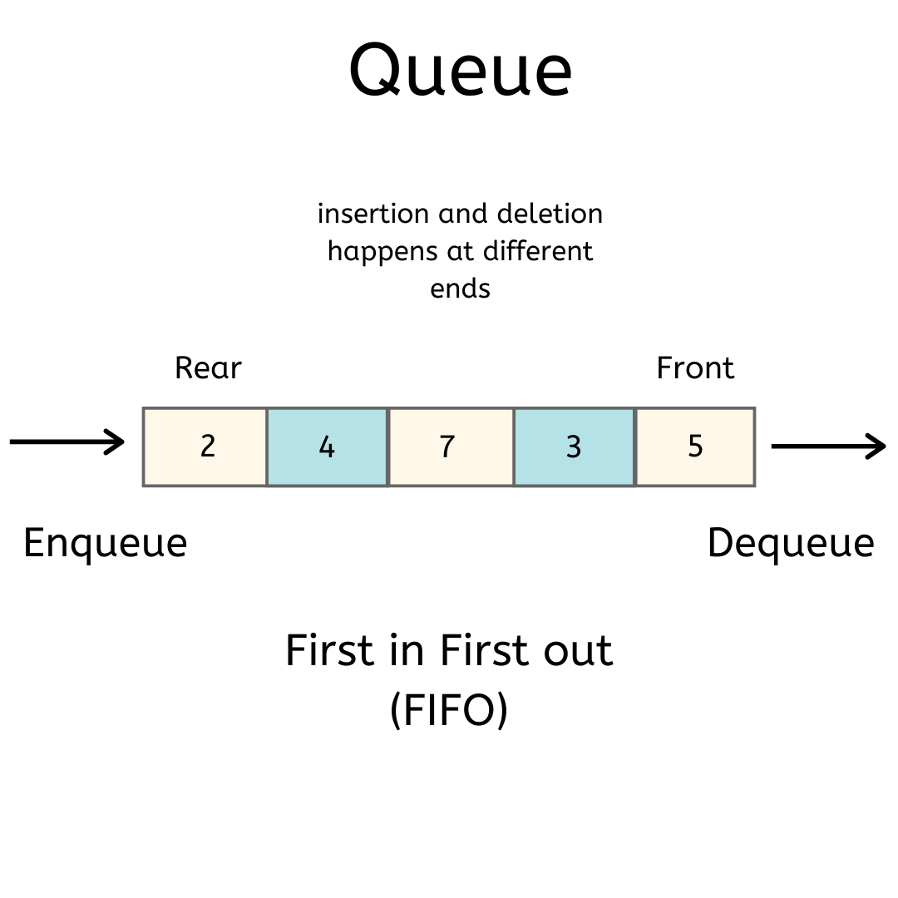
Queues for Sequential Billing Process
Queues are data structures that follow the First-In-First-Out (FIFO) principle, making them useful for managing the sequential billing process.
In a billing system, a queue can be used to store pending invoices in the order they were generated.
By processing invoices in the order they were added to the queue, the system ensures fair and systematic billing operations.
Notes:
Image source: https://prepinsta.com/data-structures/queue/

Slide 9
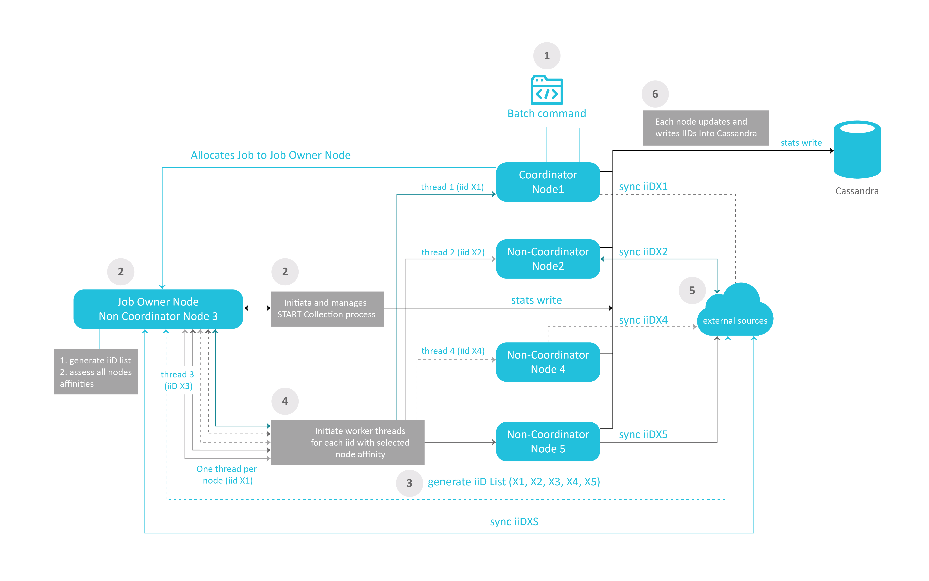
Arrays for Batch Billing Operations
Arrays provide an efficient way to store and process customer data in bulk for batch billing operations.
Customer records can be stored in an array, allowing for easy iteration and manipulation during bulk invoice generation.
Arrays offer constant-time access to elements, making them suitable for high-performance batch billing processes.
Notes:
Image source: https://support.k2view.com/Academy_6.4/articles/20_jobs_and_batch_services/17_batch_process_flow.html

Slide 10
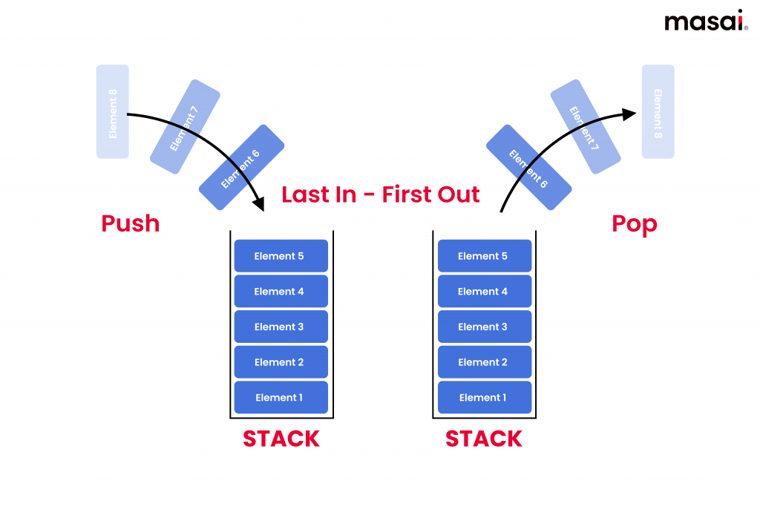
Stack for Undo/Redo Functionality
Stacks are data structures that follow the Last-In-First-Out (LIFO) principle, making them useful for implementing undo/redo functionality in billing systems.
In a billing system, a stack can be used to store previous billing actions, enabling users to undo or redo billing operations if needed.
Stacks provide a simple and efficient way to manage the order of operations and track changes in the billing system.
Notes:
Image source: https://blog.masaischool.com/stack-data-structure-explained-with-examples/

Slide 11
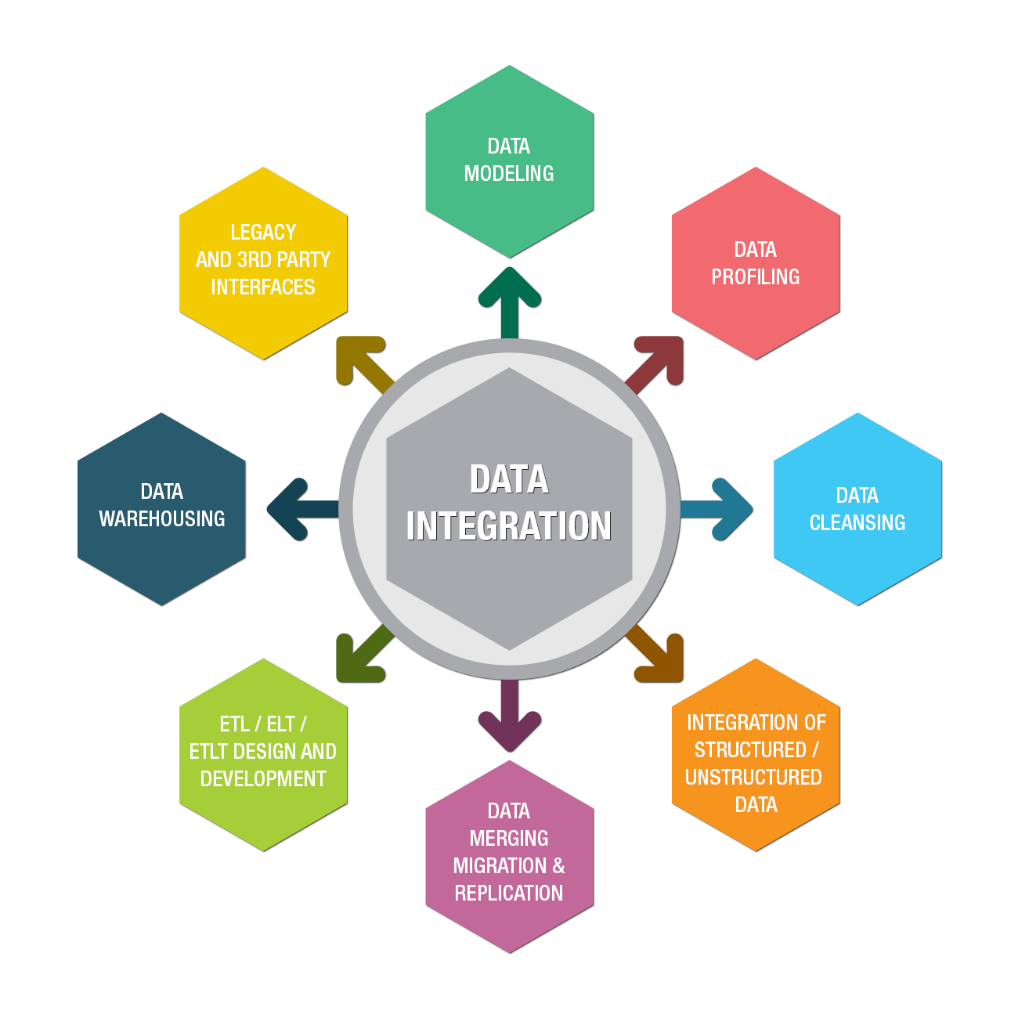
Integration of Data Structures in Customer Billing Systems
Customer billing systems often use a combination of different data structures to optimize performance and functionality.
For example, a billing system may use linked lists for customer management, hash tables for fast lookup, and arrays for batch operations.
The choice of data structures depends on the specific requirements of the billing system and the trade-offs between performance and flexibility.
Notes:
Image source: https://winsai.com/data-integration/

Slide 12
Conclusion
Customer billing systems rely on well-designed data structures to efficiently manage customer data and streamline the billing process.
By leveraging the appropriate data structures, billing systems can ensure accurate invoicing, quick access to customer information, and efficient billing operations.
Understanding the role of data structures in customer billing systems is essential for developing robust and scalable billing software.
Notes:
Image source: https://www.studytonight.com/c-projects/customer-billing-system-project-using-c-language

